Slide 1
K-Nearest Neighbors
KNN is a non-parametric and lazy learning algorithm.
Non-parametric means there is no assumption for underlying data distribution.
In other words, the model structure determined from the dataset. This will be very helpful in practice where most of the real world datasets do not follow mathematical theoretical assumptions.
Lazy algorithm means it does not need any training data points for model generation. All training data used in the testing phase. This makes training faster and testing phase slower and costlier. Costly testing phase means time and memory.
In the worst case, KNN needs more time to scan all data points and scanning all data points will require more memory for storing training data.

Slide 2
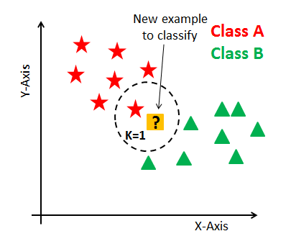
How does the KNN algorithm work?
In KNN, K is the number of nearest neighbors.
The number of neighbors is the core deciding factor.
K is generally an odd number.
Suppose P1 is the point, for which label needs to predict. First, you find the one closest point to P1 and then the label of the nearest point assigned to P1.

Slide 3
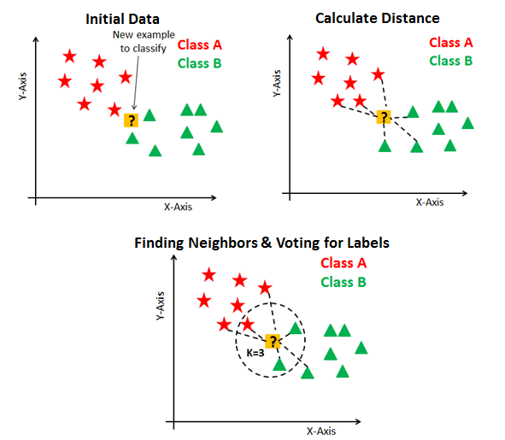
For finding closest similar points, you find the distance between points using distance measures such as Euclidean distance, Hamming distance, Manhattan distance and Minkowski distance.
KNN has the following basic steps:
Calculate distance
Find closest neighbors
Vote for labels

Slide 4
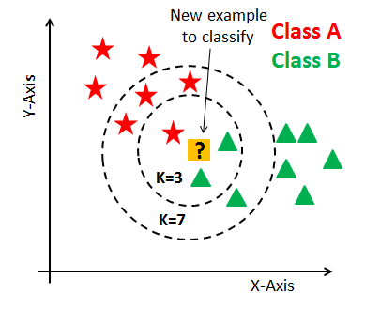
Eager learners mean when given training points will construct a generalized model before performing prediction on given new points to classify. You can think of such learners as being ready, active and eager to classify unobserved data points.
Lazy Learning means there is no need for learning or training of the model and all of the data points used at the time of prediction. Lazy learners wait until the last minute before classifying any data point. Lazy learner stores merely the training dataset and waits until classification needs to perform.
How do you decide the number of neighbors in KNN?
You can also check by generating the model on different values of k and check their performance.
You can also try Elbow method here.

Slide 5
Quick summary of KNN -
The algorithm can be summarized as:
A positive integer k is specified, along with a new sample
We select the k entries in our database which are closest to the new sample
We find the most common classification of these entries
This is the classification we give to the new sample
A few other features of KNN:
KNN stores the entire training dataset which it uses as its representation.
KNN does not learn any model.
KNN makes predictions just-in-time by calculating the similarity between an input sample and each training instance.

Slide 6
iris dataset
https://www.naftaliharris.com/blog/visualizing-k-means-clustering/
https://stanford.edu/class/engr108/visualizations/kmeans/kmeans.html
https://i.stack.imgur.com/Q7HIP.gif

